Slide 1
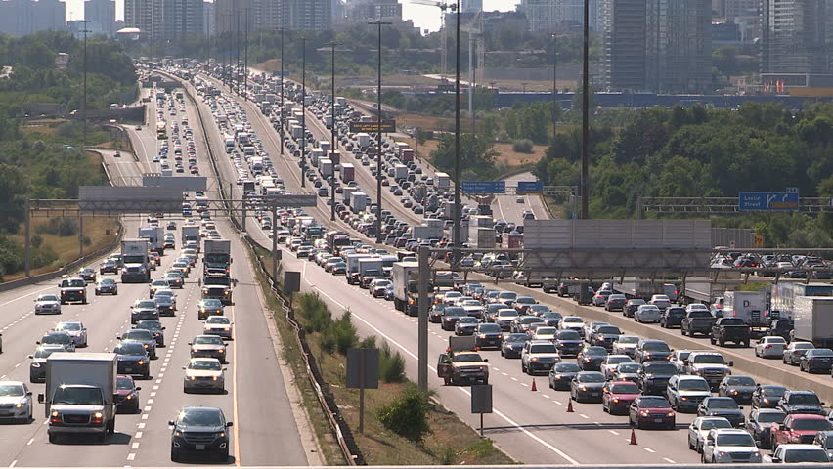
Reducing Traffic Congestion in Toronto
Ningsong Shen

Slide 2
What happened?
Notes:
Lack of public transit investment, ease of car use, cheap gas, further wealth

Slide 3
There are Too Many Private Cars
Why are there so many private cars though?
Notes:
Lost hours and time for family and work. Reduced efficiency of the flow of goods and services, which will severely hinder Toronto’s ability to compete in the future.

Slide 4
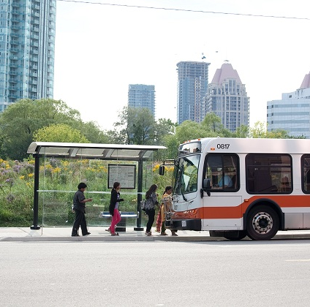
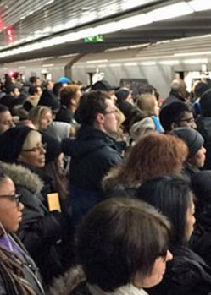
Lack of Public Transit Investment
Mississauga Buses, most come every 20-30 mins (not convenient)
Toronto Subway Yonge Line, overcrowded during morning rush

Slide 5
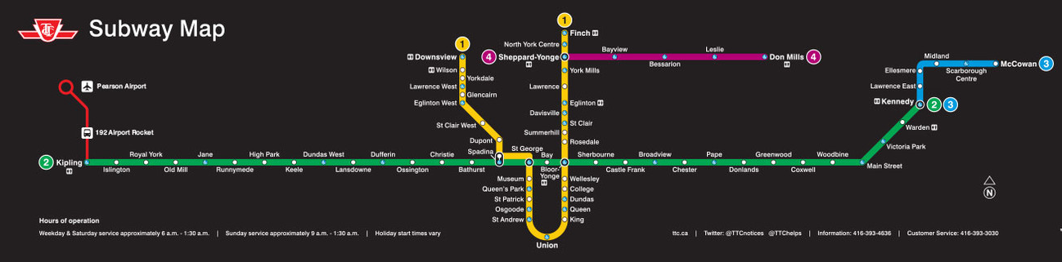
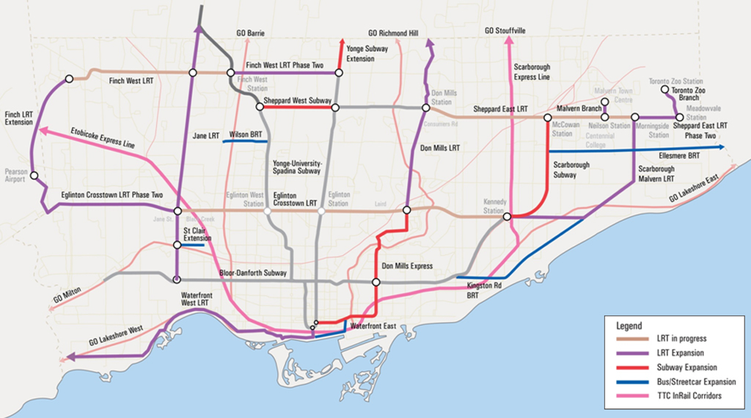
Lack of Public Transit Investment

Slide 6
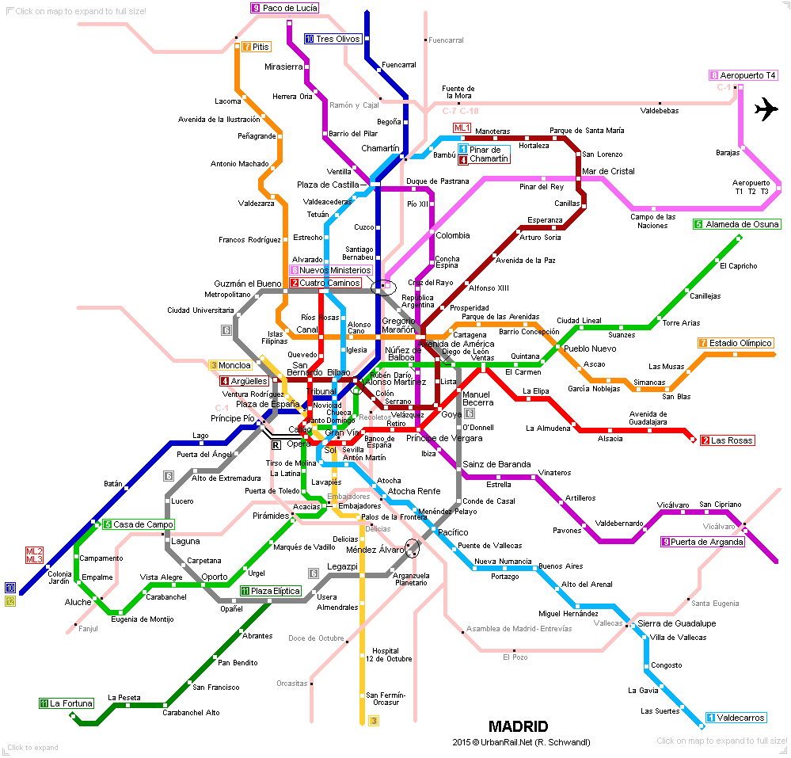
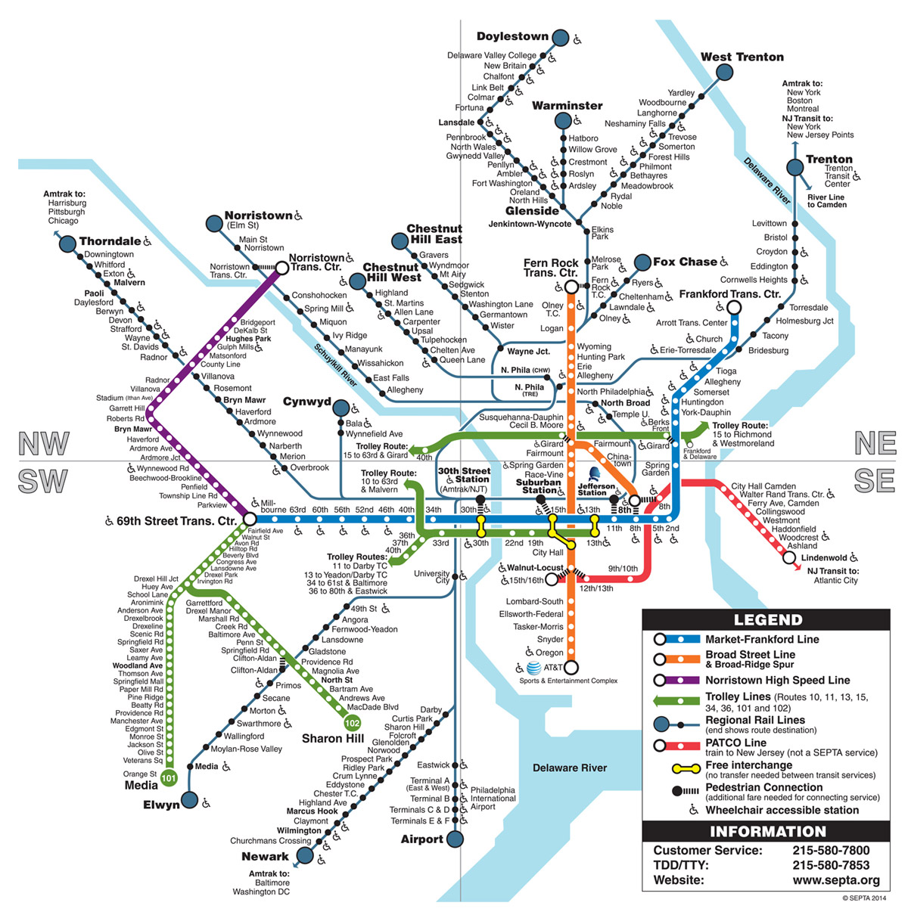
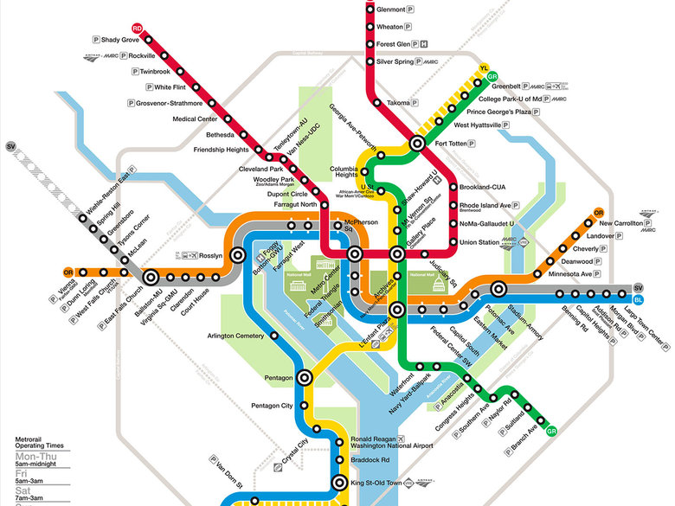
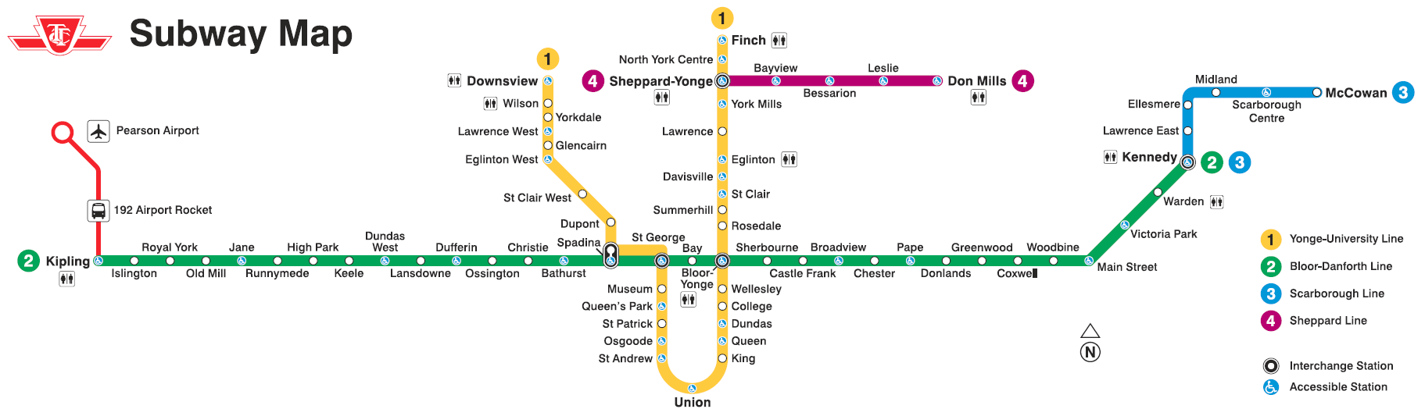
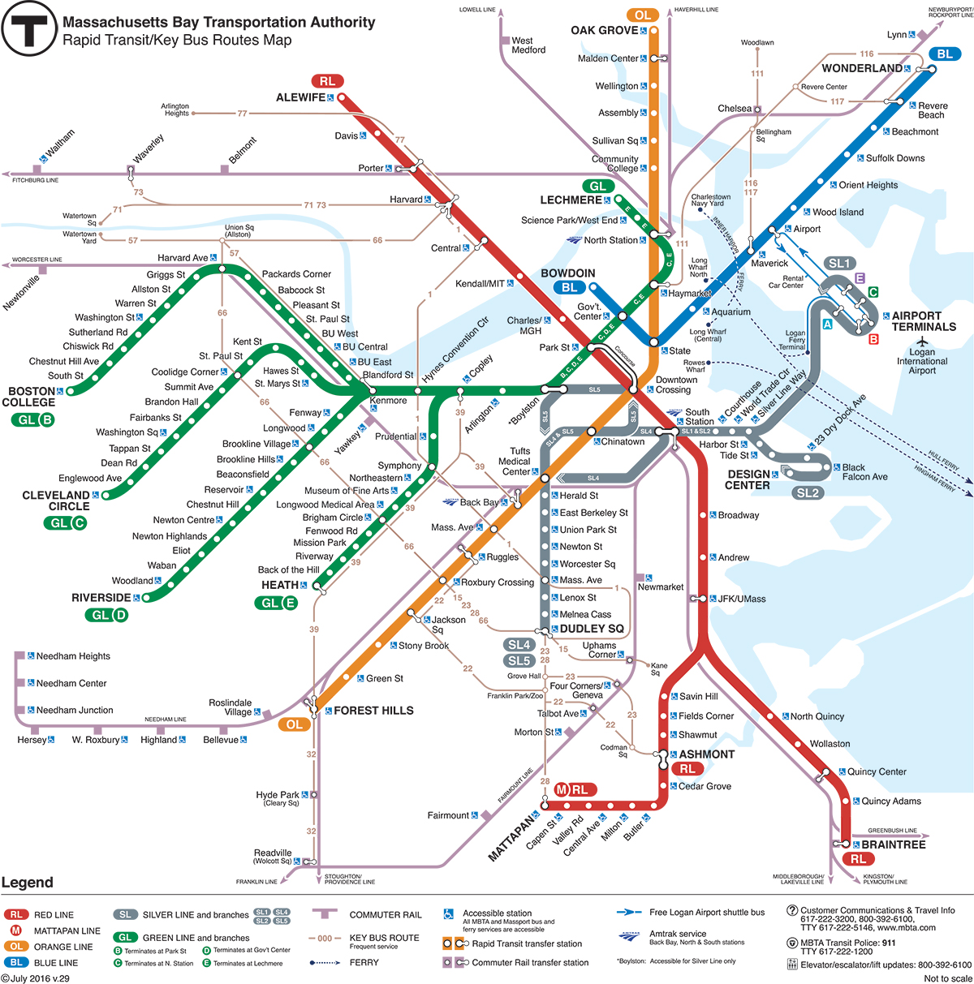
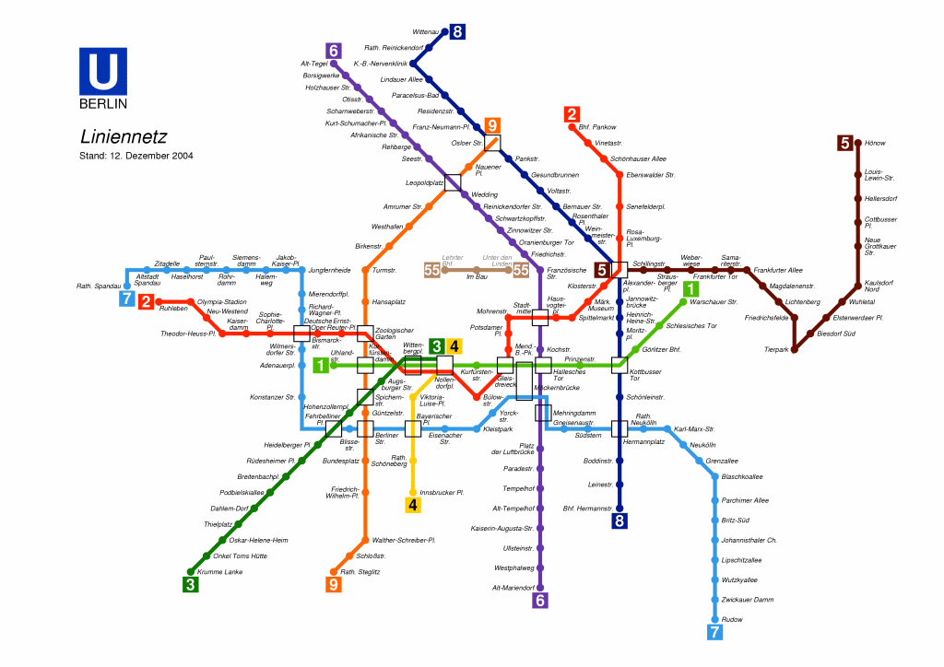
TTC RECEIVES THE LOWEST OPERATING SUBISDY OF NORTH AMERICA, ONLY 78c PER RIDER
Notes:
Compared to most other municipalities, at $1.5 to $2

Slide 7
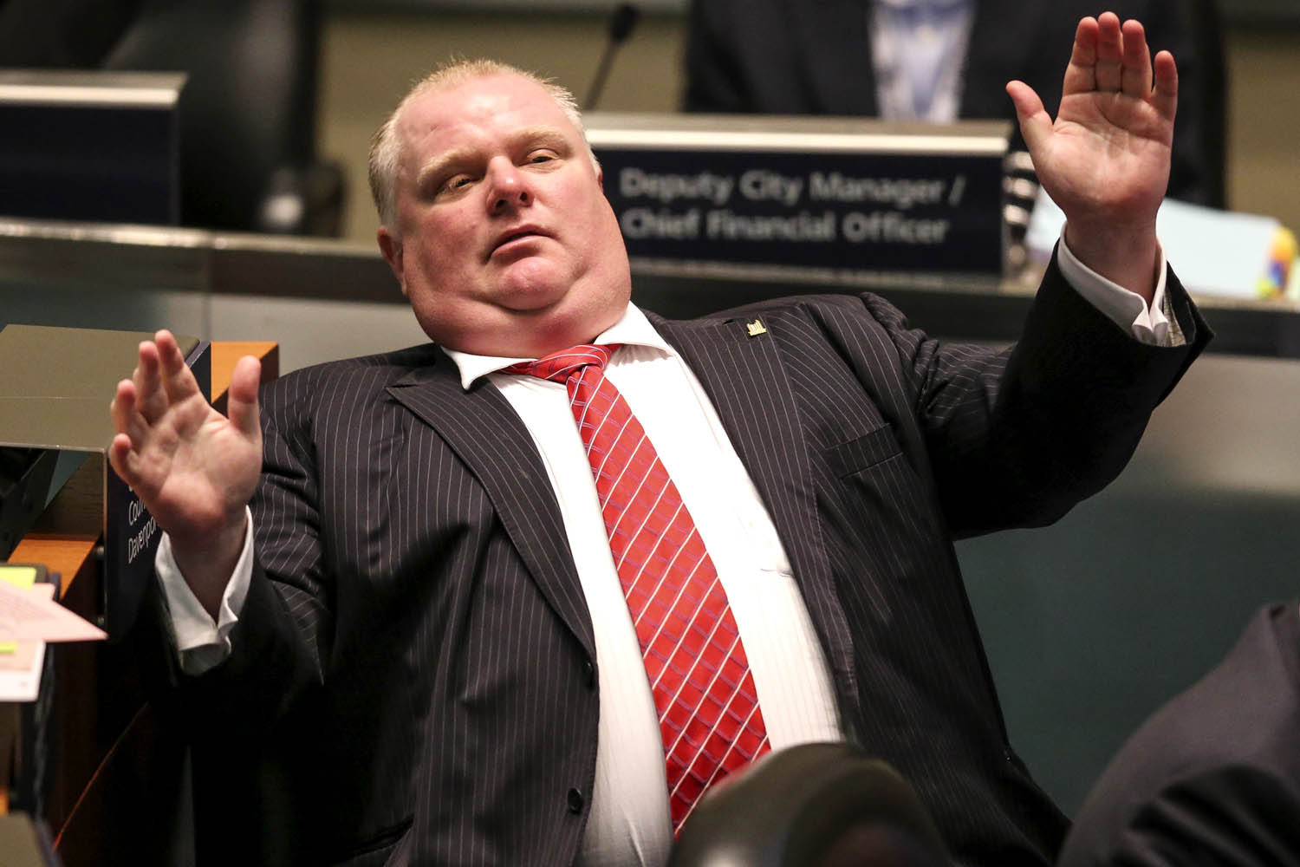
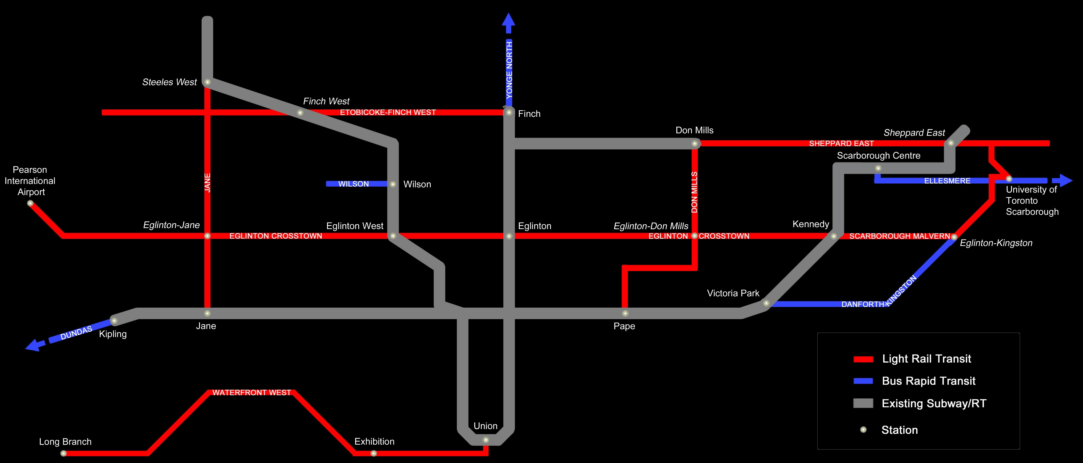
Lack of Public Transit Investment

Slide 8
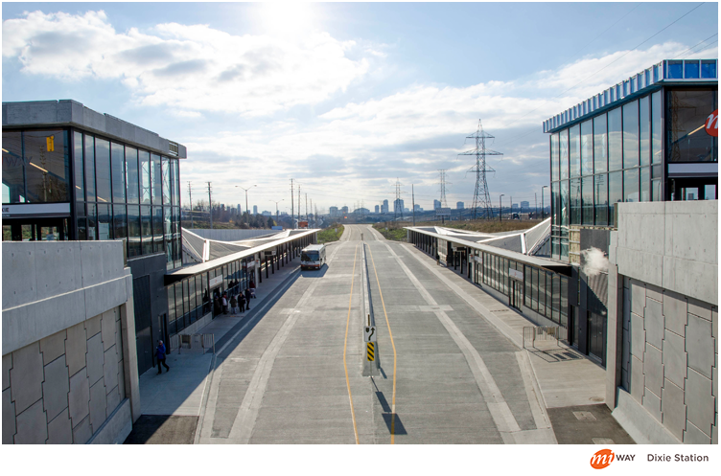
Poor Public Transit Investment
Mississauga Transitway was built in the middle of nowhere
Getting to stations almost always requires a car
Politicians always want ‘new stuff’

Slide 9
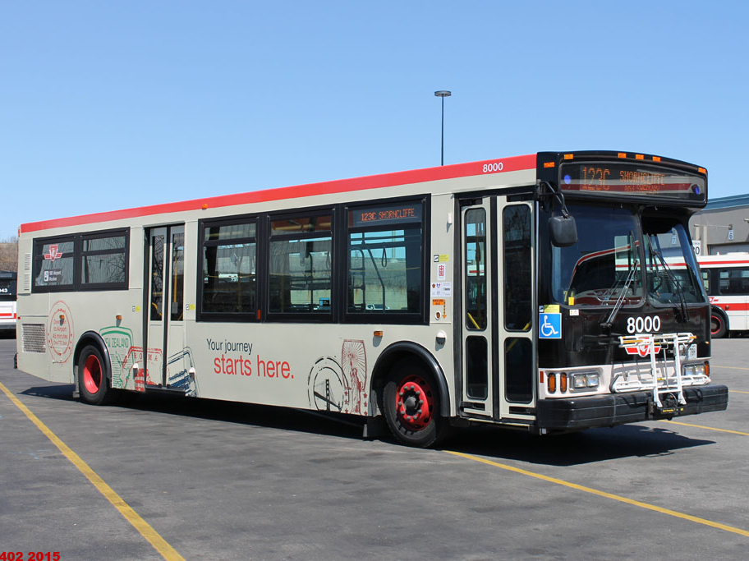
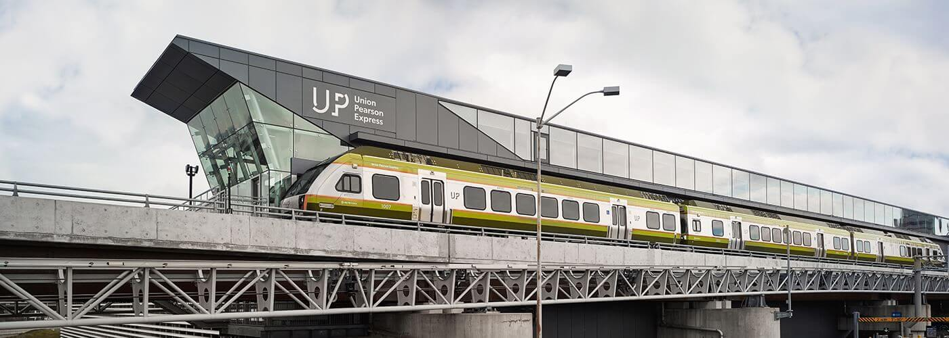
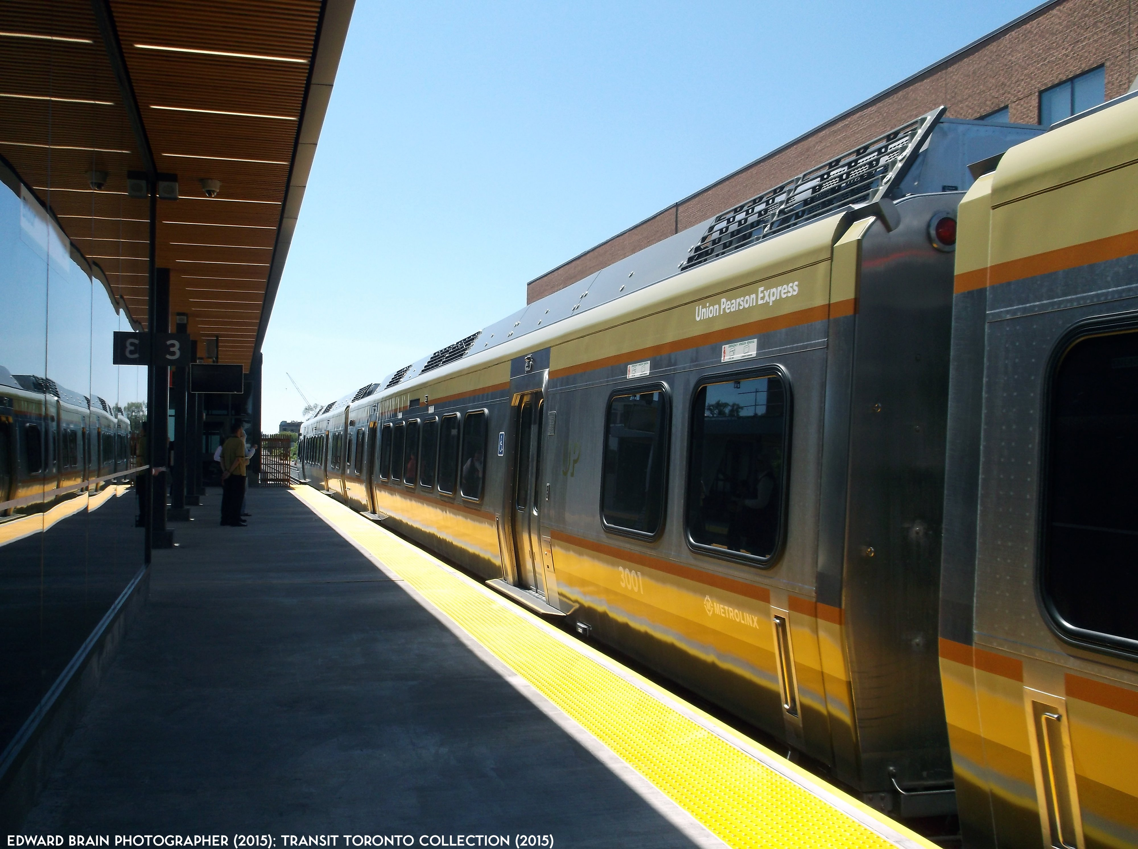
Poor Public Transit Investment
UP Express has extremely low ridership
Notes:
UP Express: 3x the price, ½ time

Slide 10
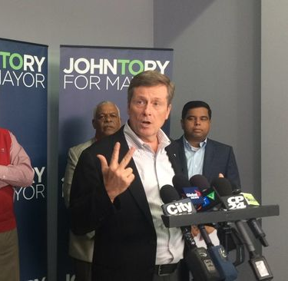
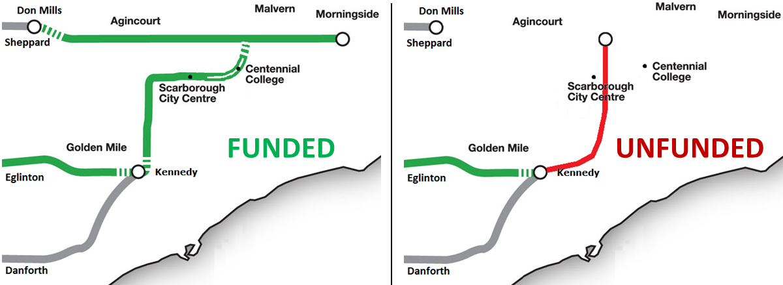
Poor Public Transit Investment
The SSE has been a political fiasco

Slide 11
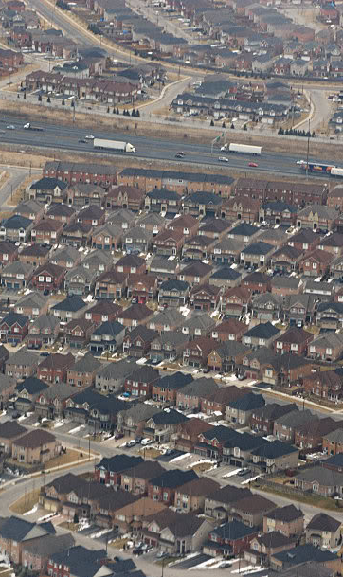
Car-Centric communities
Sprawling subdivisions
Expansive highways
Dead-end streets
Huge single-family homes
Really, the ‘Canadian Dream’?

Slide 12
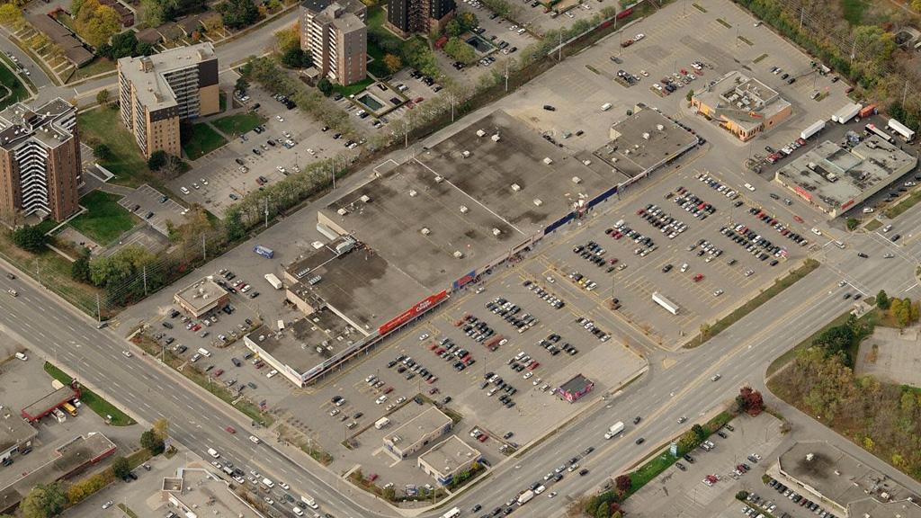
Car-Centric communities
Gigantic parking lots
Pedestrian unfriendly streets
Large Chain stores

Slide 13
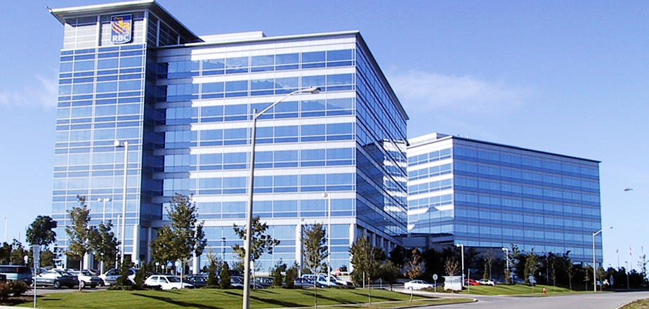
Car-Centric communities
Large office parks
Large car parking lots
Little Transit to get to work

Slide 14
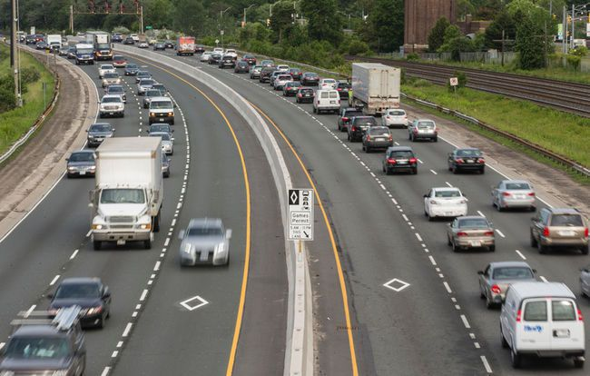
Little Education on Alternatives
Only 5% of GTA commuters carpool, compared to 65% drive privately

Slide 15
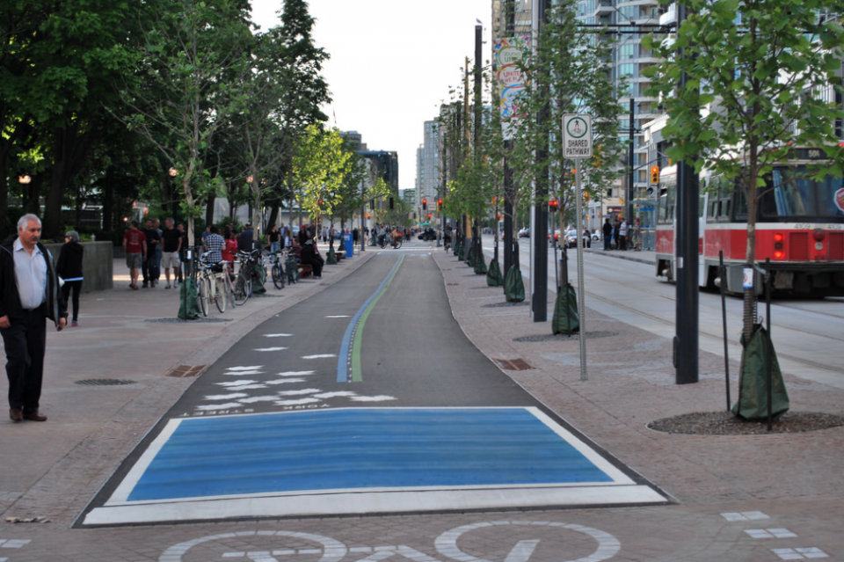
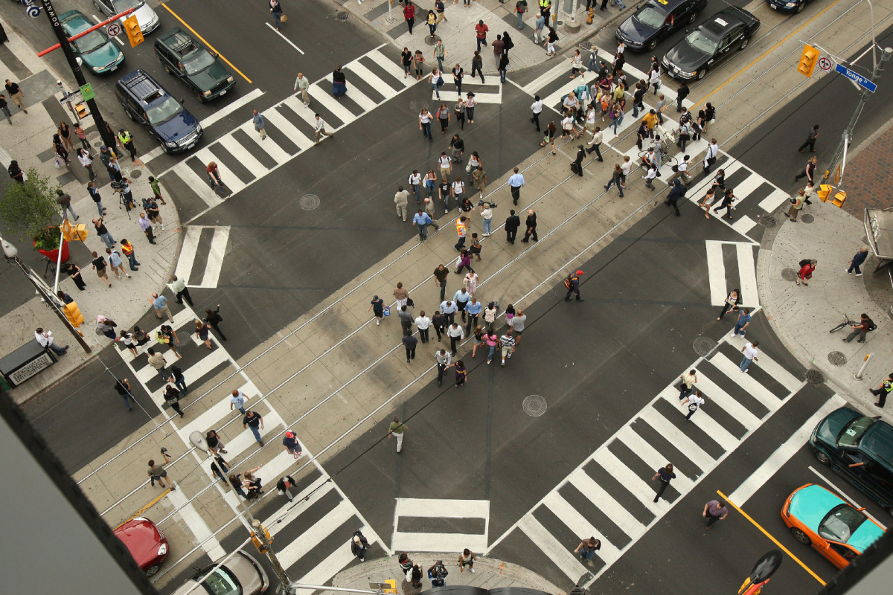
Little Education on Alternatives
Even fewer bike or walk

Slide 16
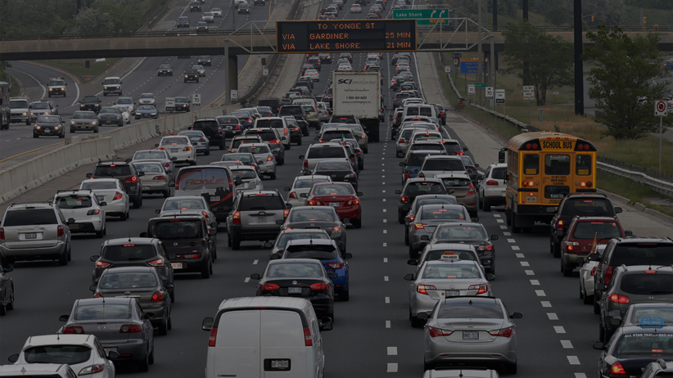
Little Education on Alternatives
What’s your perception on transit, walking or cycling to work?
When was the last time you heard about a campaign?

Slide 17
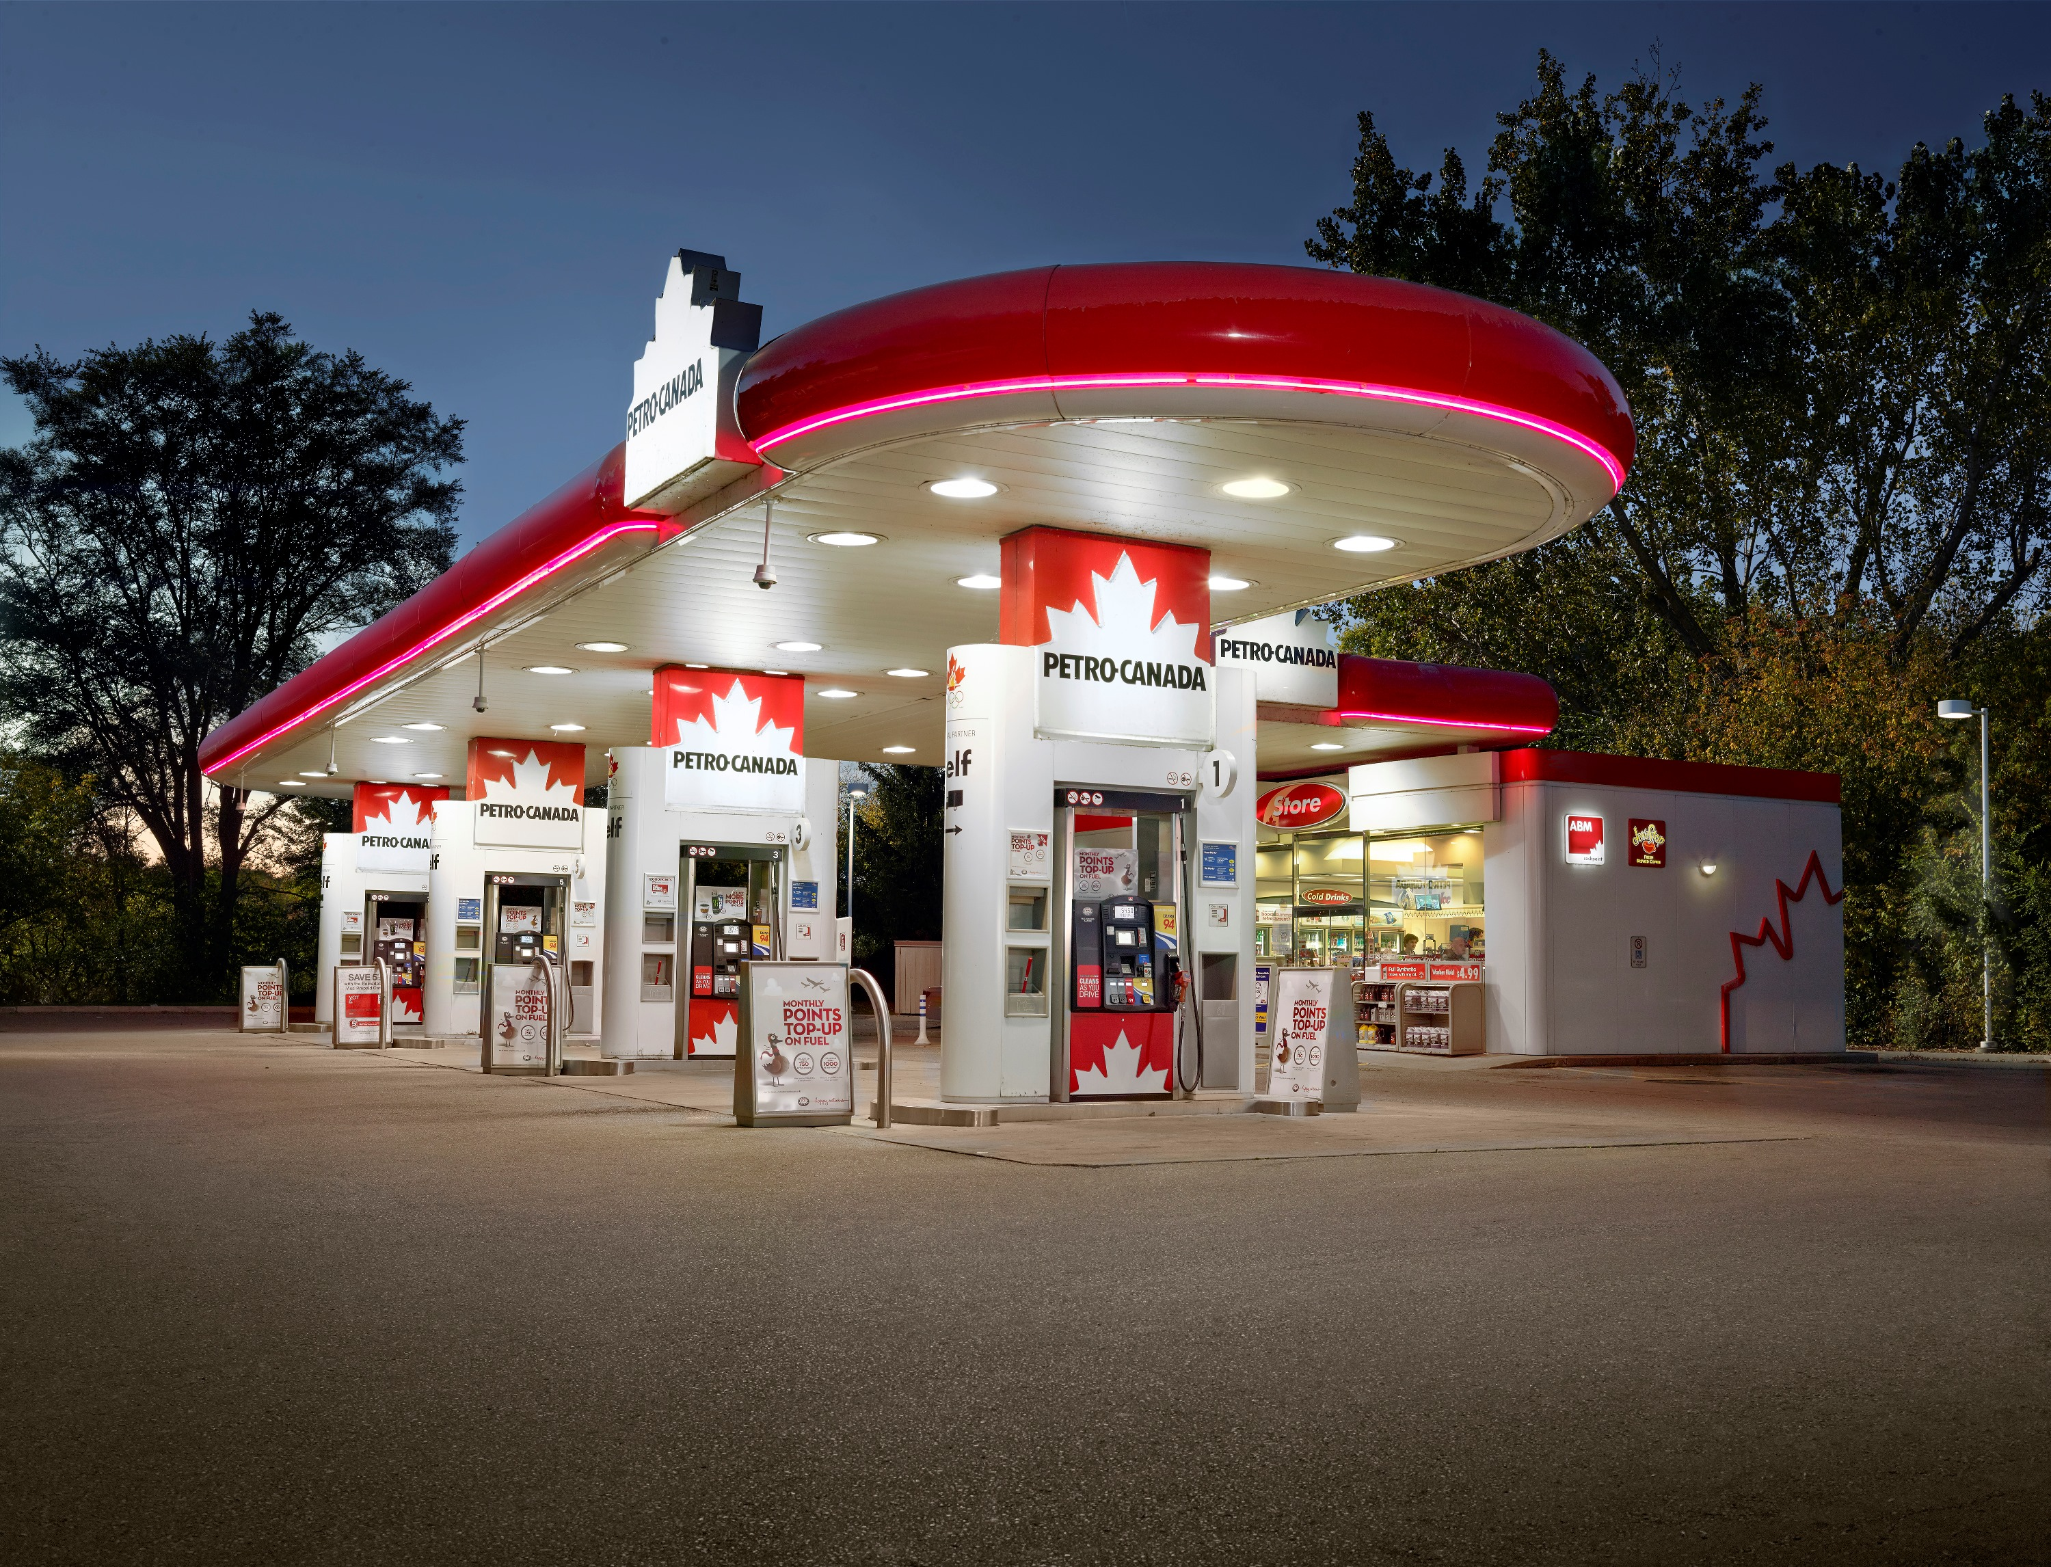
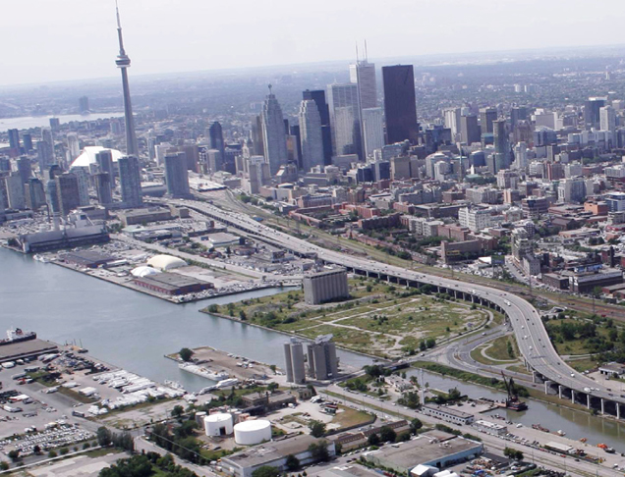
Incentives to Use Private Cars
Cheap gas
Continuous highway construction
Notes:
Even politicians support highways, because they’ll ‘reduce’ congestion. In reality, they generally increase the # of people driving, and soon the new highway fills up. This is INDUCED DEMAND

Slide 18
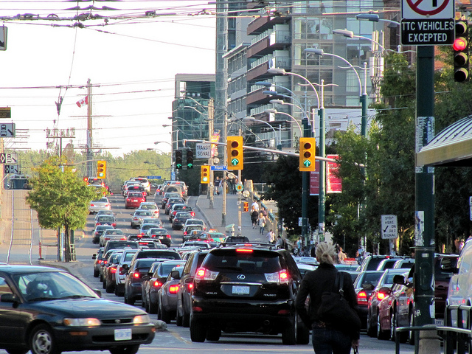
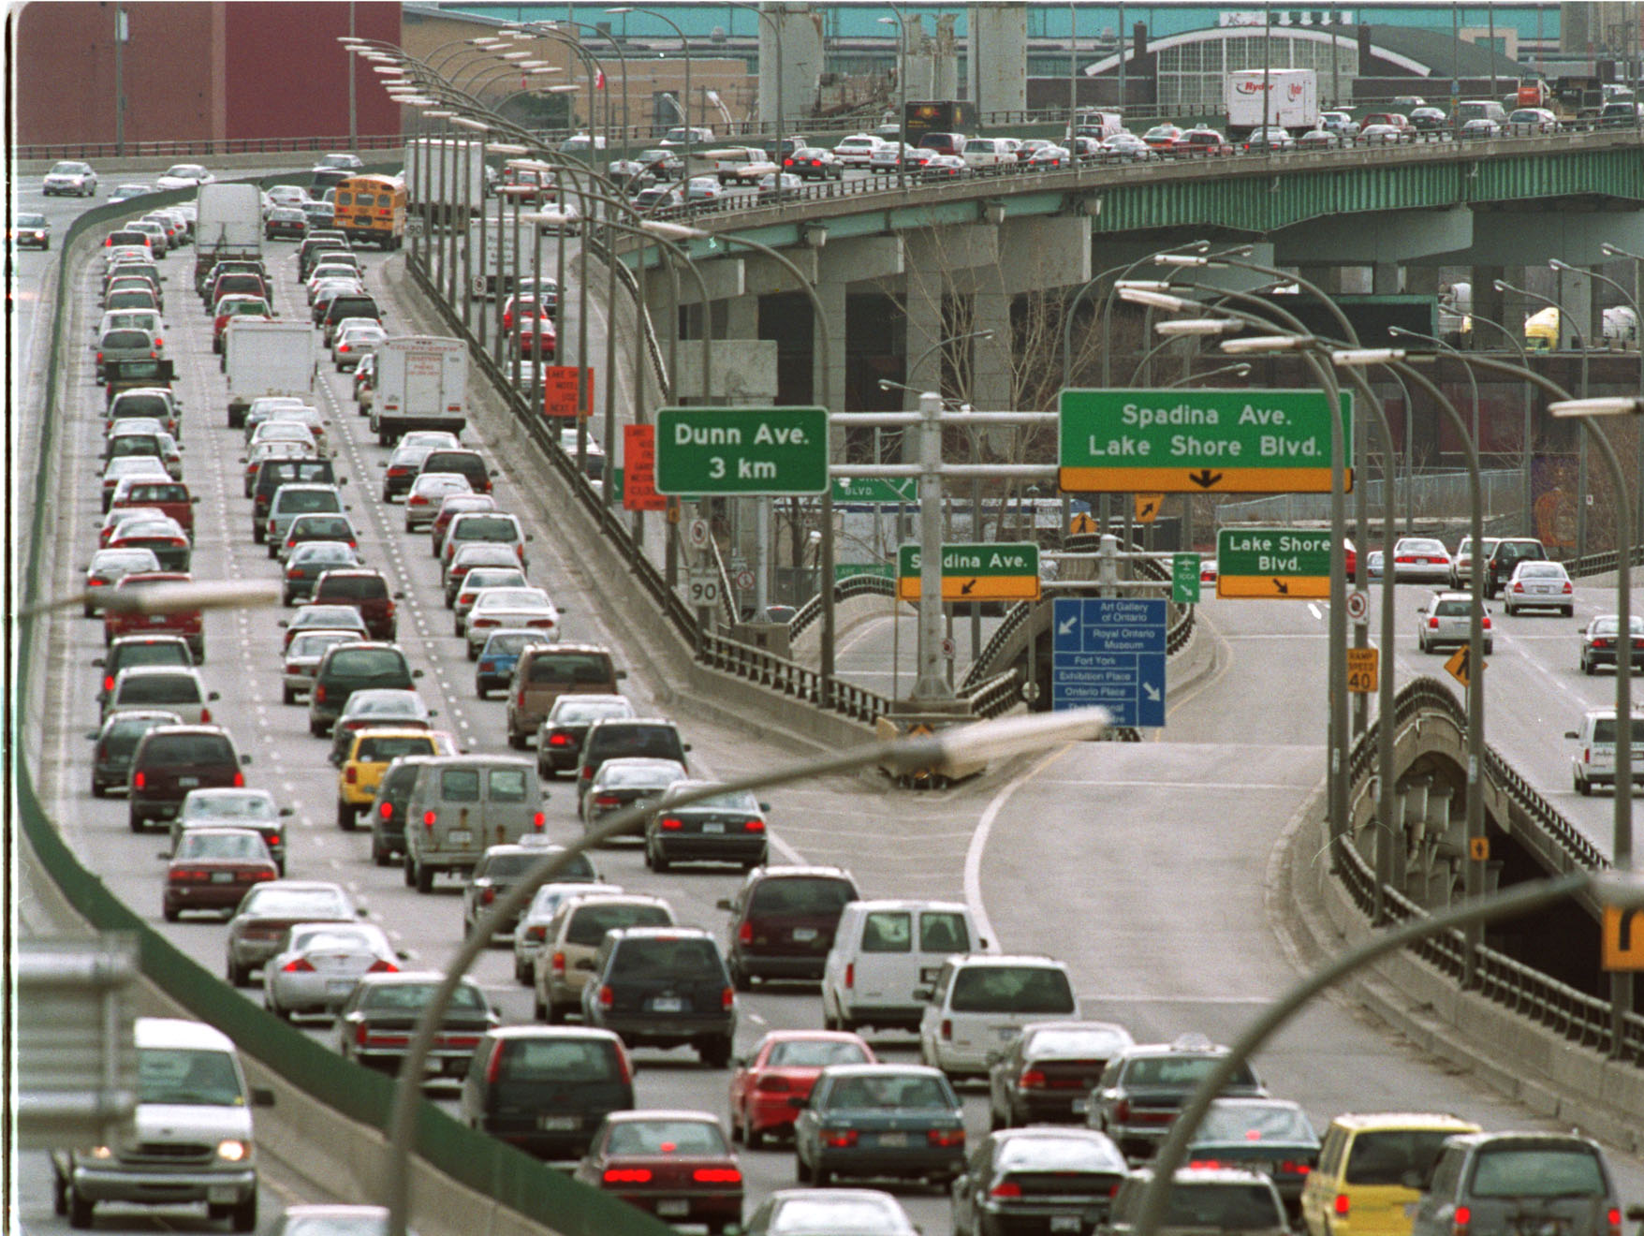
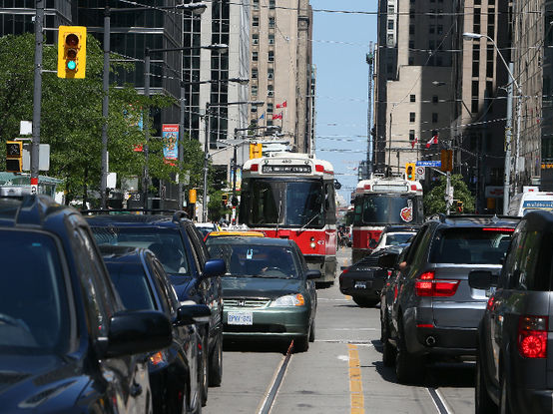
It is now the normal
Notes:
Everyday, we are stuck in traffic.

Slide 19
Problems:
Costing commuters $3.3 billion per year
Costing the environment $7.8 billion per year
Costing the economy $2.7 billion per year
Lost time with family and at work
Will only get worse with a growing population

Slide 20
Objectives

Slide 21
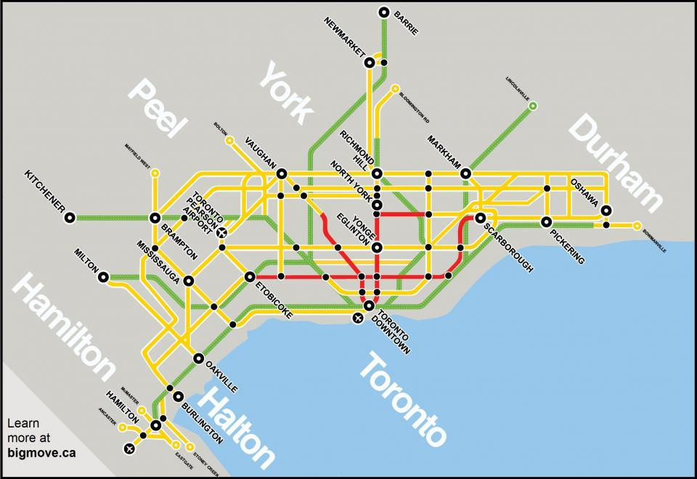
Make Transit Convenient In the GTA
And Increase Ridership
4%
Notes:
Increase Transit Usage by 4% a year. How? Continue to build more according to the plan. And improve existing services (frequency, route, comfort)

Slide 22
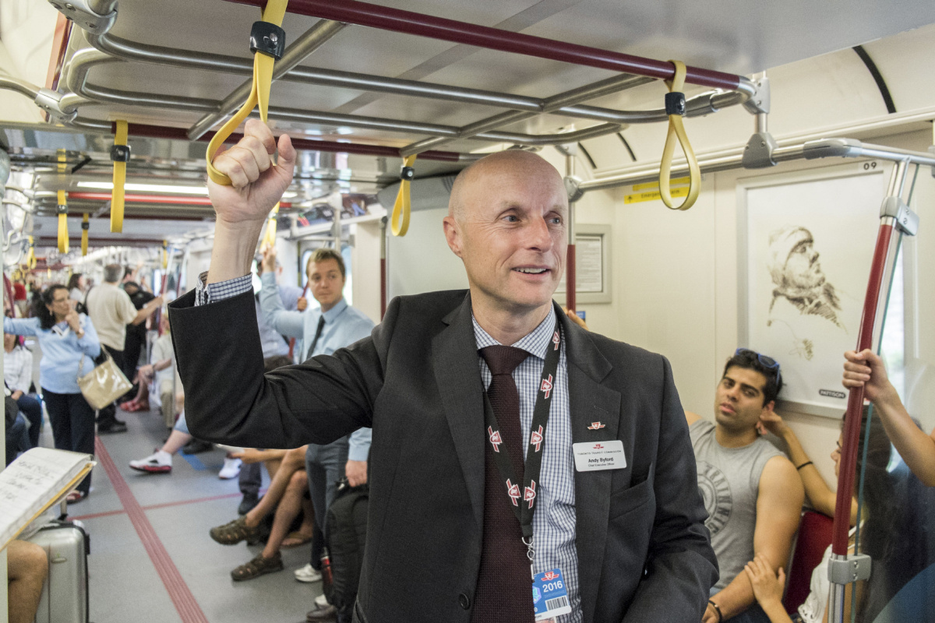
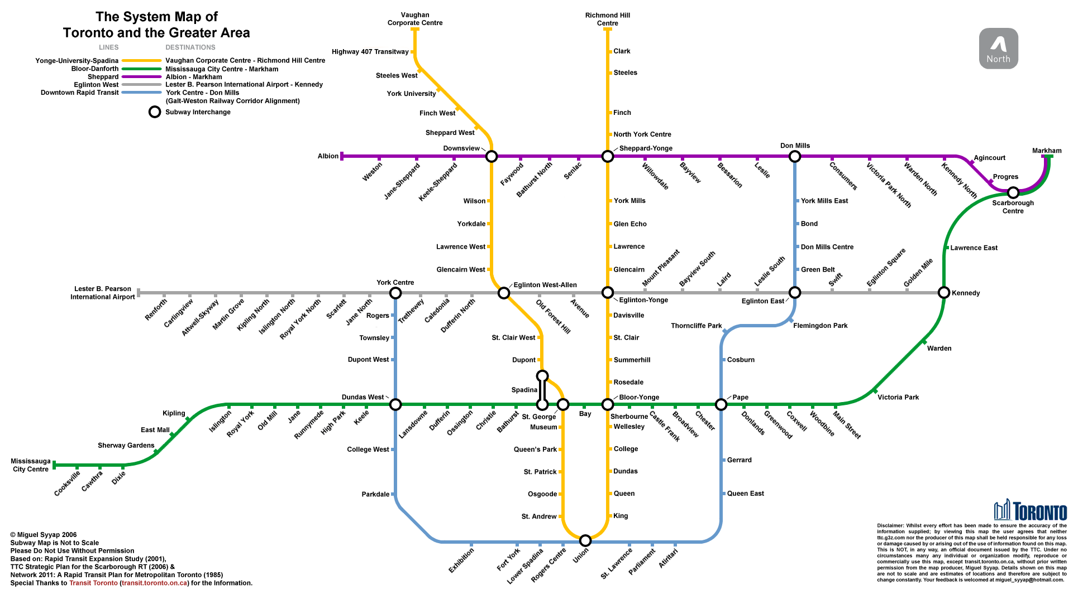
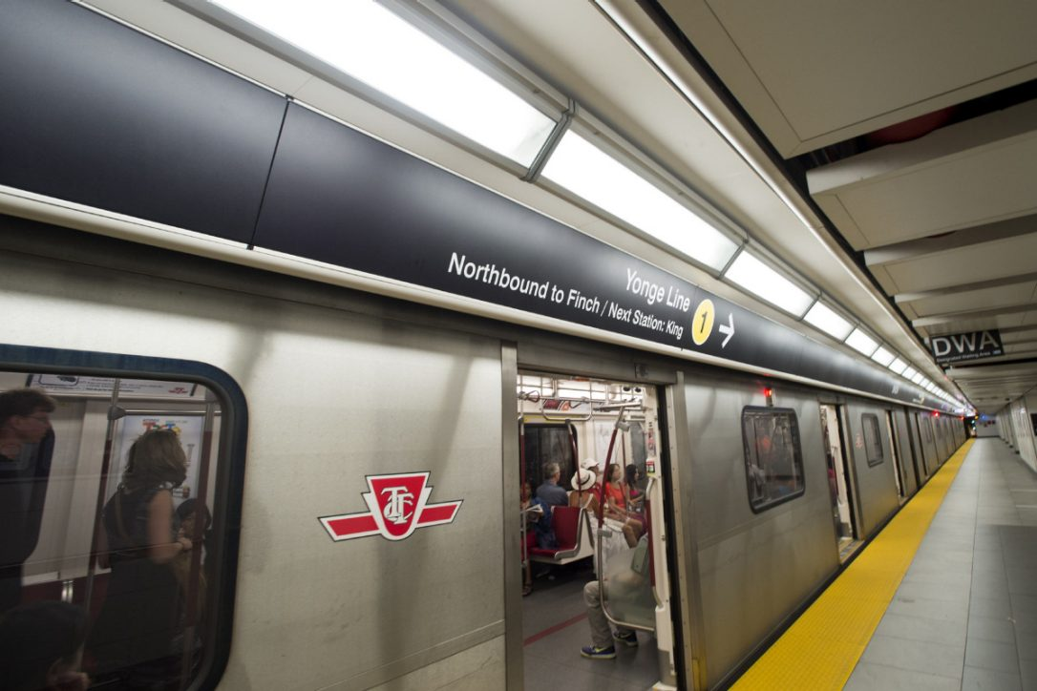
Make Transit and Traffic Planning the Job of Specialists, not Politicians
Notes:
Part of that plan is to do this. Politics always gets in the way.

Slide 23
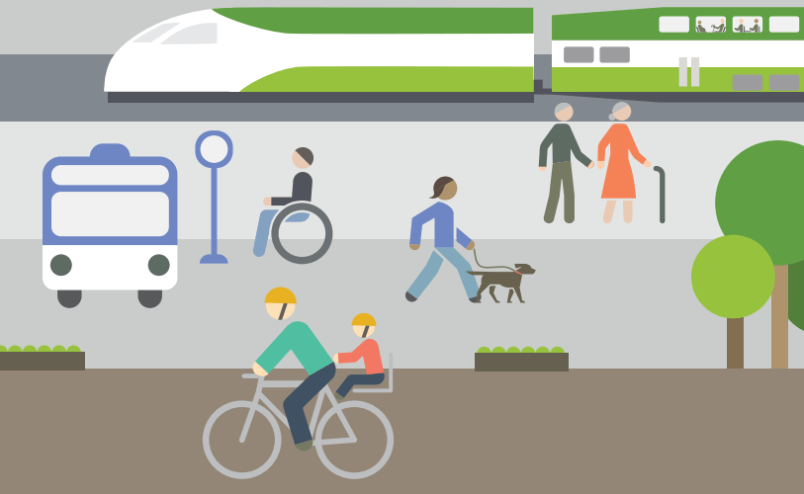
Increase Active Transportation
Walking
Biking

Slide 24
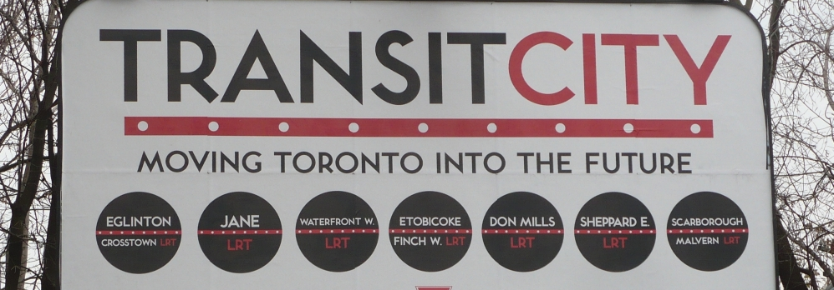
Have a Visible Campaign to Educate Commuters
Notes:
Campaign, and educate about the alternatives

Slide 25
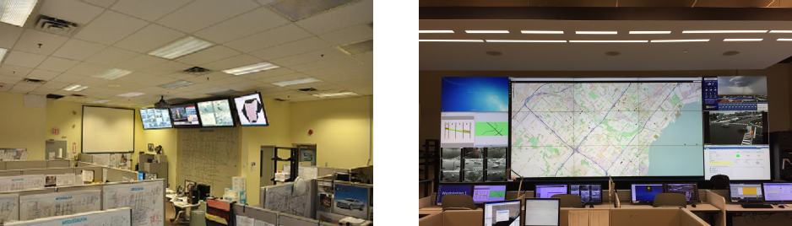
Use Technology To Reduce Congestion
Notes:
Advanced Traffic Management Systems and Intelligent Transportation Systems

Slide 26
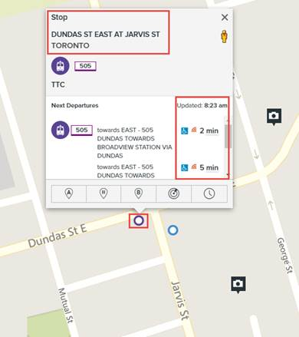
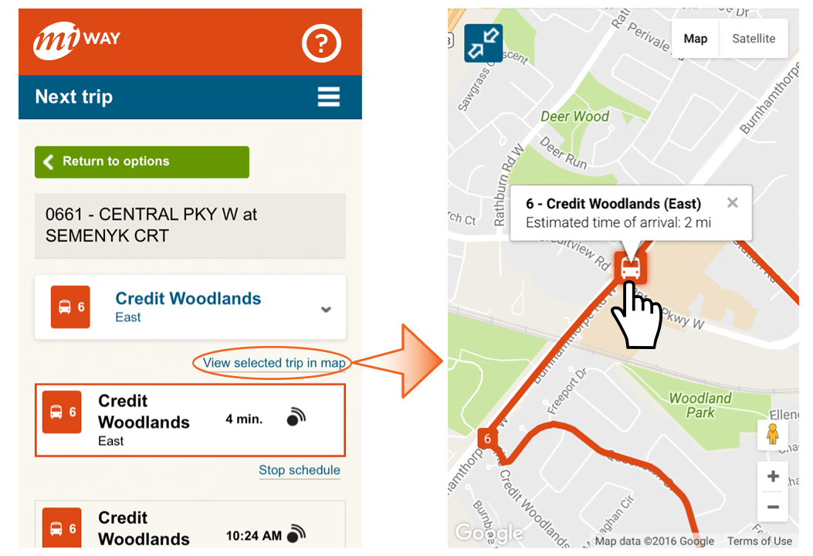
Use Technology To Reduce Congestion
Notes:
Real-time departures on your smartphone, computer, tablet…

Slide 27
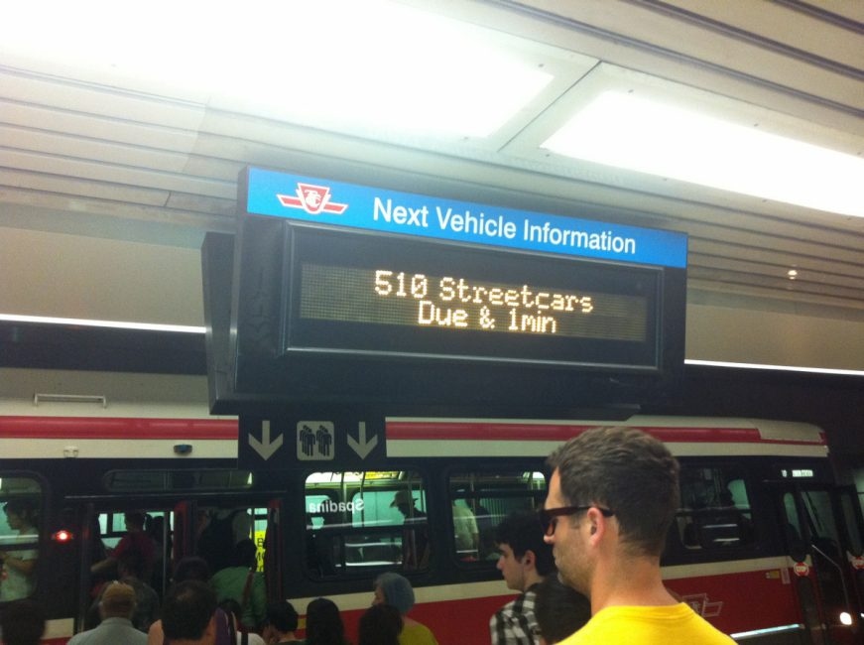
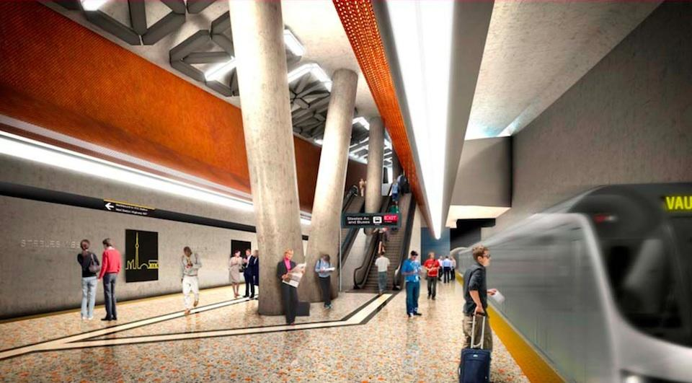
Use Technology To Reduce Congestion
Notes:
Electronic Information Screens. Better Designed Stations

Slide 28
Actions

Slide 29
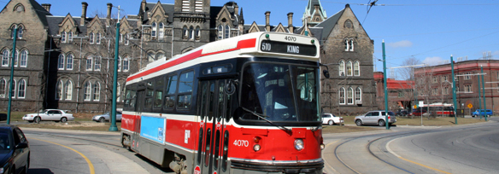
A Citizen Committee
Notes:
Covers all of the GTA, represents all commuters and a push for better transit, walking and cycling facilities and goals

Slide 30
Reach out to Politicians
Through emails and letters to the politicians
Reaching out at events
Speaking with votes
Continue with the current plan of transit building
Commit to not reducing funding for transit and active transportation
Modernize Traffic Systems

Slide 31
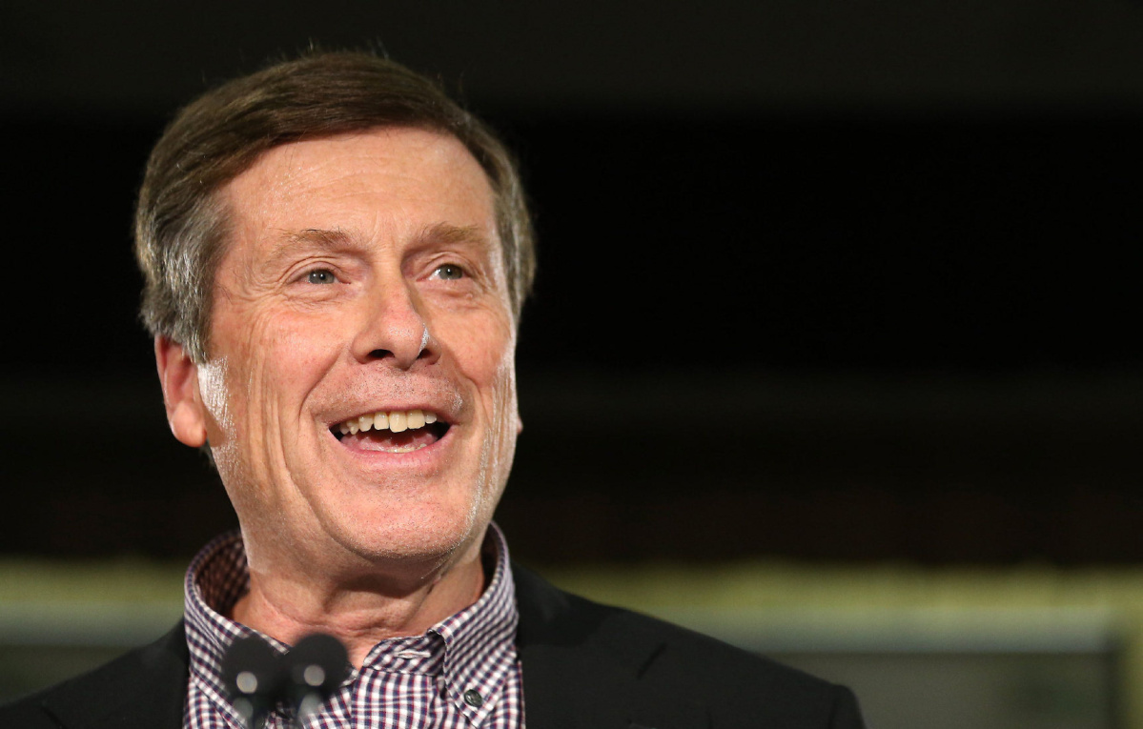
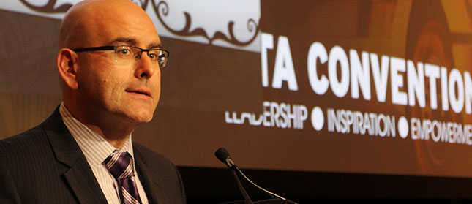
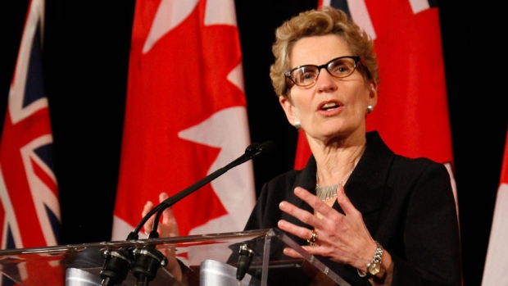
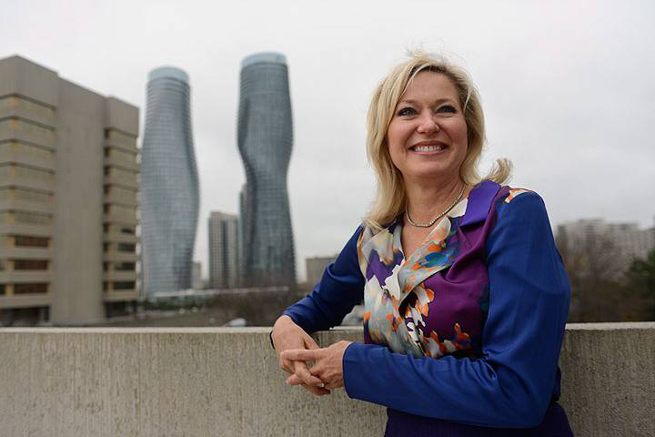
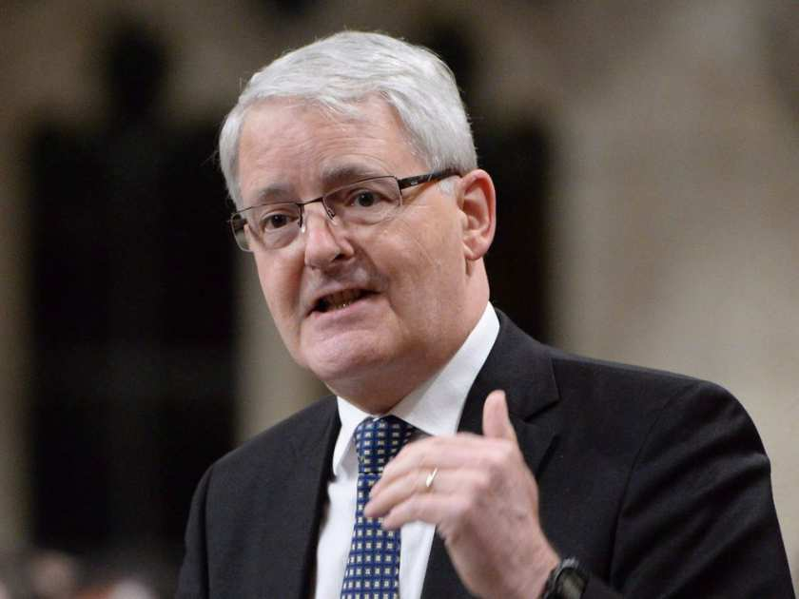


Slide 32
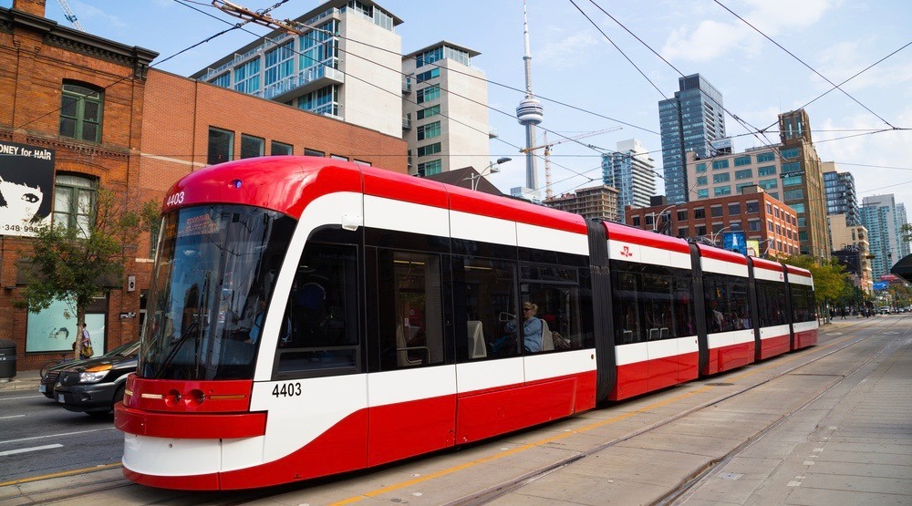
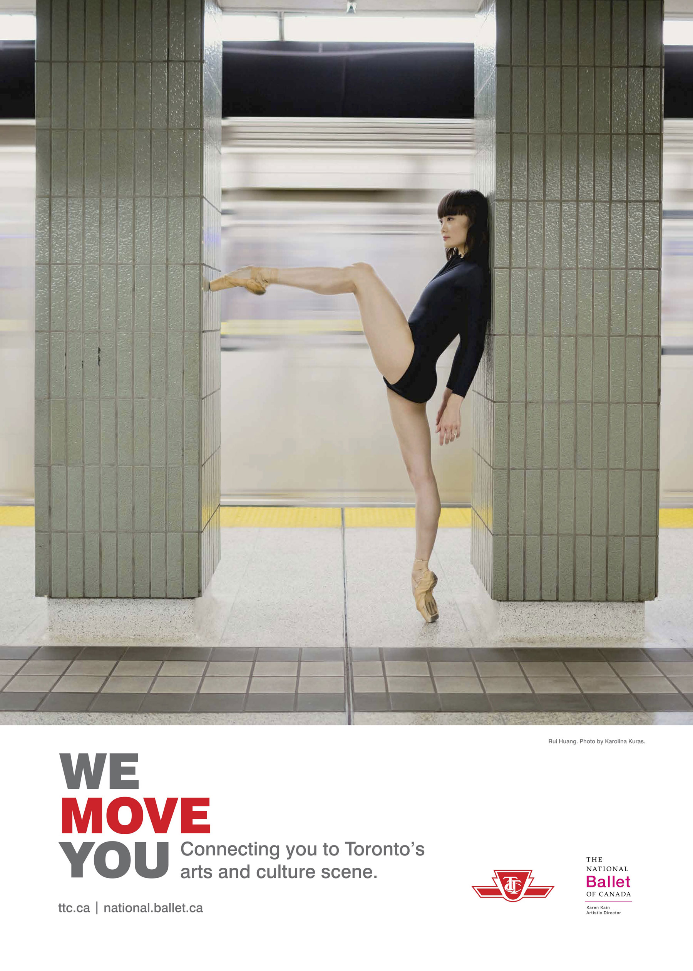


Educate and Communicate With the Community
Advertisements
Social Media
Events
News Sources

Slide 33


Take Transit

Slide 34

Take Transit

Slide 35

Take Transit

Slide 36

Take Transit

Slide 37

Take Transit

Slide 38

Take Transit

Slide 39

Take Transit

Slide 40

Take Transit

Slide 41

Walk

Slide 42

Bike

Slide 43

Incentivize Commuters to Use Alternative Methods
Add HOV Lanes on all highways

Slide 44

Incentivize Commuters to Use Alternative Methods
Improve Frequency and Reliability of existing service to a convenient level

Slide 45



Incentivize Commuters to Use Alternative Methods
Integrate fares regionally (options currently being studied)

Slide 46

New Developments Should Ensure Pedestrian and Transit Friendliness

Slide 47

New Developments Should Ensure Pedestrian and Transit Friendliness

Slide 48



Petition to Create a New Separate Body to Manage Transit in Toronto
Modelled after TfL
Will not let politics get in the way of what is good for the city
Notes:
This is not the committee which is citizen run, this is government run. Citizens advocate, government

Slide 49
Reducing Traffic Congestion in Toronto
Notes:
These are the solutions that will reduce congestion in Toronto. One of the problems that we have here is that because we are built to such car oriented sizes, most of the time walking and cycling will not be viable options until those gigantic parking lots and wide roads are filled with high density development. Until then, we will have to focus on improving transit, and that is why transit is the largest pat of the campaign.

Slide 50
TAKE
TRANSIT
TORONTO
And the suburbs too
Notes:
And so, remember to Take Transit Toronto.

